Slide 1

Enhancement Request: Capture Transaction data from SQS queue

Slide 2
PROJECT OVERVIEW:
•Goal: Capture real-time transaction data from an SQS queue sent by source systems
(e-commerce) and store it in the DynamoDB.
•Objective: Automate real-time transaction ingestion using AWS SQS and Lambda, storing the data in DynamoDB.

Slide 3
Data Processing approach
Lambda 1:
Generates transaction data.
Retrieves acc_no from the Acct_master table in DynamoDB.
Generates additional transaction details
SQS Queue:
The generated transaction data, along with acc_no from DynamoDB is sent to the SQS Queue.
Lambda 2:
Triggered by new messages in the SQS queue.
Validates the data based on specific conditions.
DynamoDB:
After validation, Lambda 2 stores the data in the ledger_txn table in DynamoDB.

Slide 4
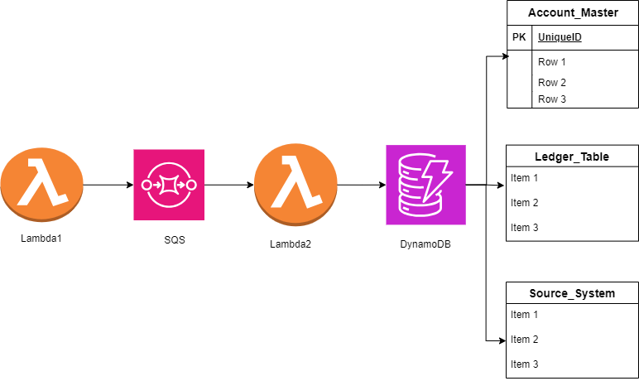
ARCHITECTURE DIAGRAM

Slide 5
Technologies used
The services used in this project are:
Amazon SQS (Simple Queue Service): Used to receive and store real-time transaction data from the external system in the form of messages.
AWS Lambda: A serverless compute service used to process, validate, and transform the incoming transaction data from the SQS queue.
Amazon DynamoDB: A NoSQL database used to store the processed transaction data and log any failed transactions for further investigation and error handling.
Amazon CloudWatch: A monitoring service used to track the status and performance of the Lambda functions and other resources involved in the transaction processing pipeline.

Slide 6
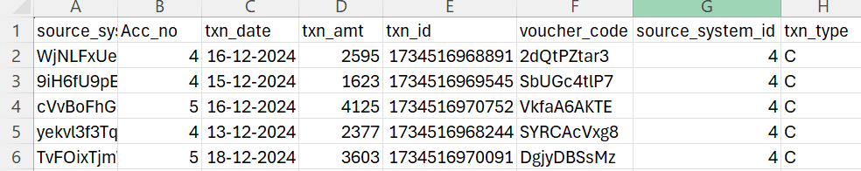
OUTPUT

Slide 7
THANK YOU

